Slide 1
If Statements

Slide 2
Objectives
What is an IF Statement and how are they used?
What is the correct syntax?
How do you structure if-elif-else to carry out multiple tests?
What are Boolean Expressions?
What are comparison operators?
Using IF statements with Lists and Loops

Slide 3
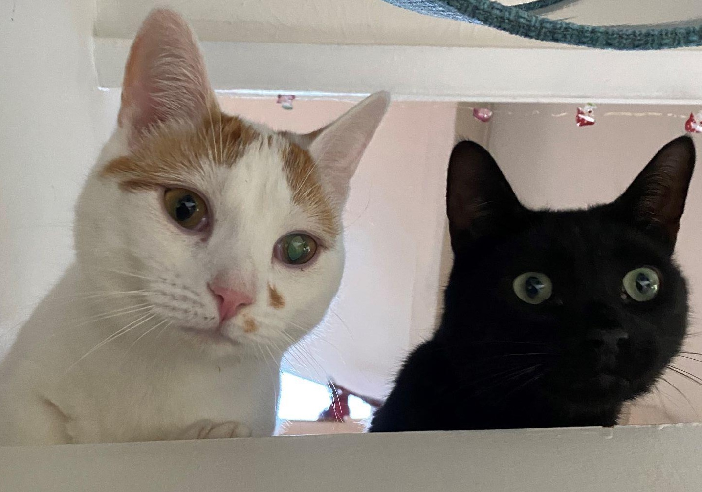
Back to Dinner… Weasley and Noche Problem

Slide 4
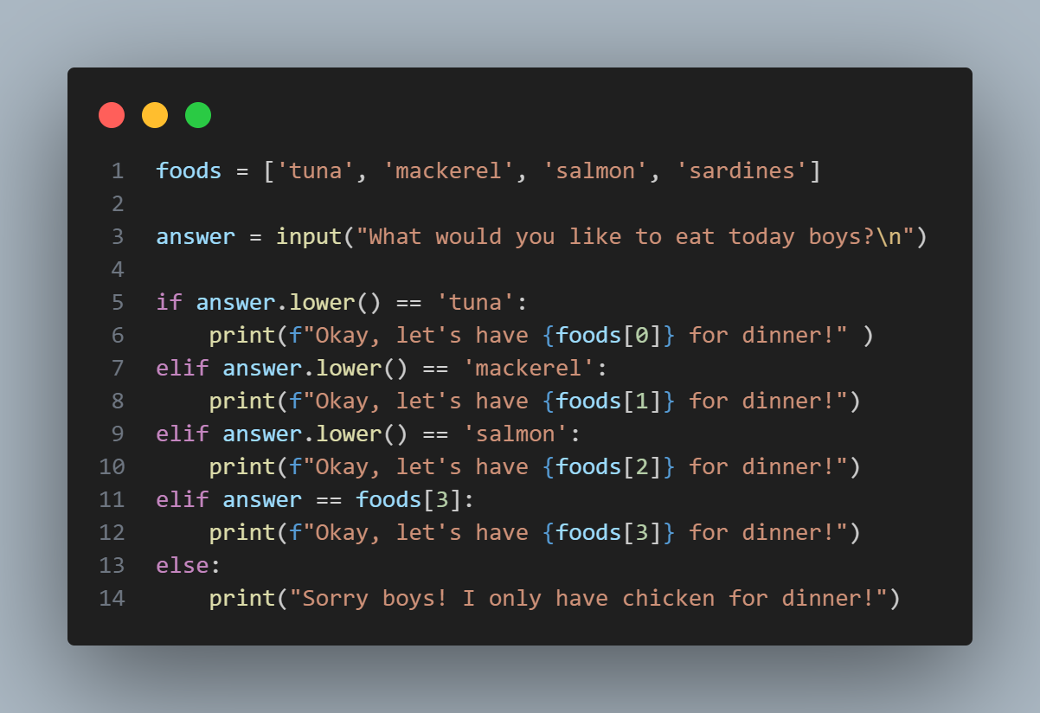
Notes:
foods = ['tuna', 'mackerel', 'salmon', 'sardines']
answer = input("What would you like to eat today boys?\n")
if answer.lower() == 'tuna':
print(f"Okay, let's have {foods[0]} for dinner!" )
elif answer.lower() == 'mackerel':
print(f"Okay, let's have {foods[1]} for dinner!")
elif answer.lower() == 'salmon':
print(f"Okay, let's have {foods[2]} for dinner!")
elif answer == foods[3]:
print(f"Okay, let's have {foods[3]} for dinner!")
else:
print("Sorry boys! I only have chicken for dinner!")
What would happen if I ran this?

Slide 5
Boolean Expressions
This is a name for a conditional test - it is checking for whether or not something is TRUE or FALSE.
You can imagine all of the use cases for this!

Slide 6
If Statements
If statements are conditional statements. They look for whether a statement is true or false, then it can do something based on the result.
A really good example, is making a decision for a meal at a restaurant….

Slide 7
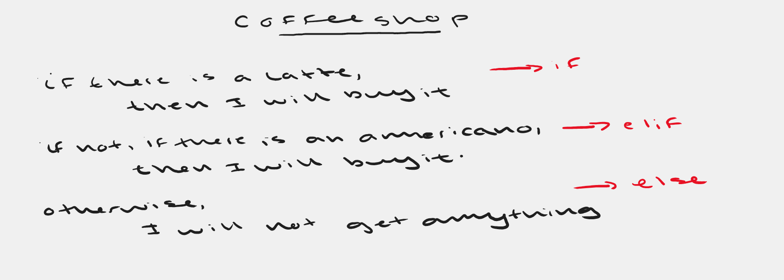
Notes:
I like to give an example of a coffee shop here. When you go to a coffee shop, you usually have some form of idea of what you want. A latte, americano, croissant… So if there is a latte, I will get one. If not, then I will get an americano. If both are not available, I will not get anything. I like to explain the idea of conditional statements; Python is looking for whether something is true of false then will do something depending on the result. I find drawing it out really helps. When I finish explaining my coffee shop idea, I usually then draw it out as an if, elif, and else statement. Just showing that it is the same scenario, just written in a different way.

Slide 8
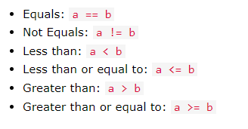
Comparison Operators
Notes:
Show in Python Terminal Examples
Refer to program from beginning to show use case of conditional operators.

Slide 9
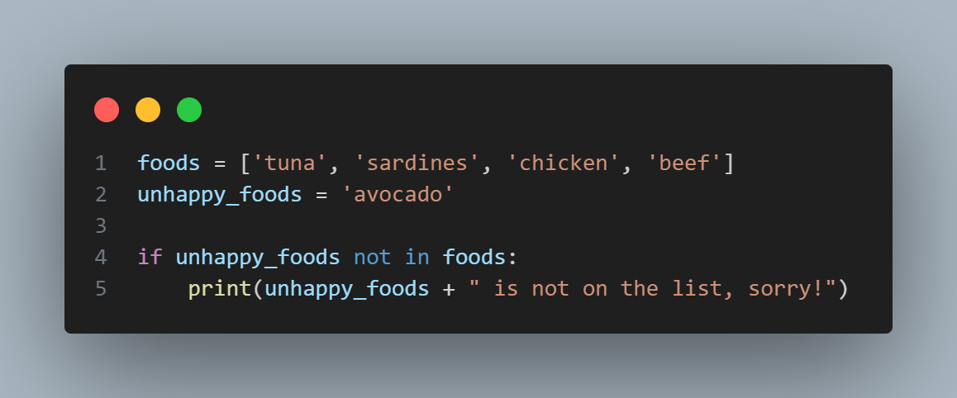
Checking Whether an Item is not in a list
Notes:
foods = ['tuna', 'sardines', 'chicken', 'beef']
unhappy_foods = 'avocado'
if unhappy_foods not in foods:
print(unhappy_foods + " is not on the list, sorry!")
foods = ['tuna', 'sardines', 'chicken', 'beef', 'avocado']
unhappy_foods = 'avocado'
if unhappy_foods not in foods:
print(unhappy_foods + " is not on the list, sorry!")
else:
print("Hooray we have it!")

Slide 10
If - elif - else
Notes:
foods = ['tuna', 'mackerel', 'salmon', 'sardines']
answer = input("What would you like to eat today boys?\n")
if answer.lower() == 'tuna':
print(f"Okay, let's have {foods[0]} for dinner!" )
elif answer.lower() == 'mackerel':
print(f"Okay, let's have {foods[1]} for dinner!")
elif answer.lower() == 'salmon':
print(f"Okay, let's have {foods[2]} for dinner!")
elif answer == foods[3]:
print(f"Okay, let's have {foods[3]} for dinner!")
else:
print("Sorry boys! I only have chicken for dinner!")

Slide 11
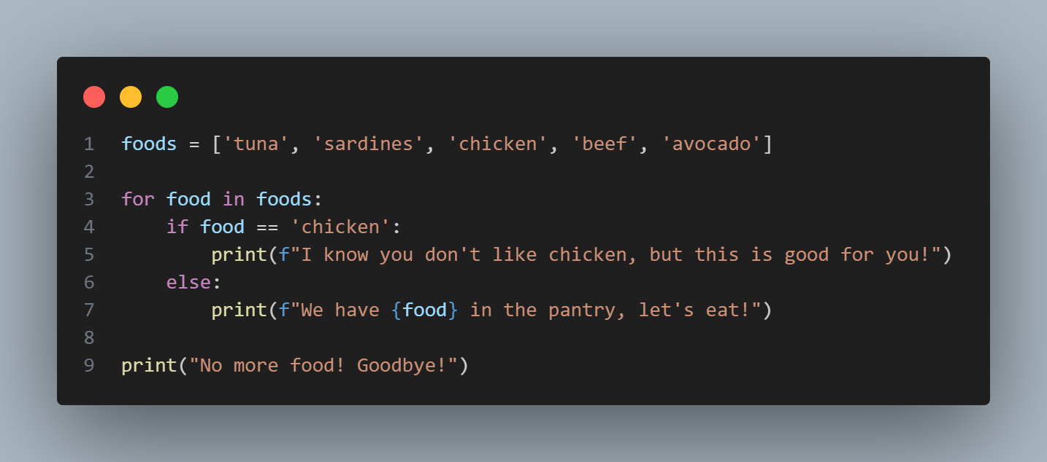
Using if statements with loops and lists
Notes:
foods = ['tuna', 'sardines', 'chicken', 'beef', 'avocado']
for food in foods:
if food == 'chicken':
print(f"I know you don't like chicken, but this is good for you!")
else:
print(f"We have {food} in the pantry, let's eat!")
print("No more food! Goodbye!")

Slide 12
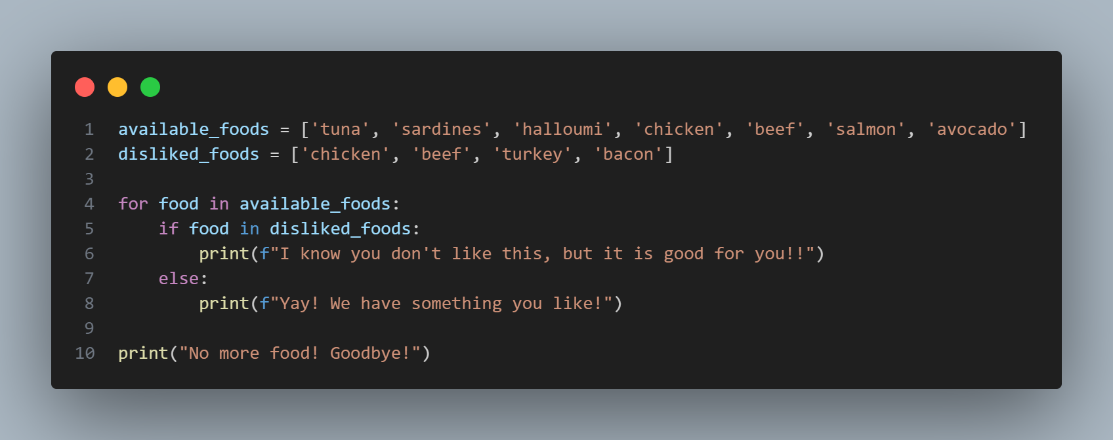
Having Multiple Lists!
Notes:
available_foods = ['tuna', 'sardines', 'halloumi', 'chicken', 'beef', 'salmon', 'avocado']
disliked_foods = ['chicken', 'beef', 'turkey', 'bacon']
for food in available_foods:
if food in disliked_foods:
print(f"I know you don't like this, but it is good for you!!")
else:
print(f"Yay! We have something you like!")
print("No more food! Goodbye!")

Slide 13
Notes:
foods = ['tuna', 'mackerel', 'salmon', 'sardines']
answer = input("What would you like to eat today boys?\n")
if answer.lower() == 'tuna':
print(f"Okay, let's have {foods[0]} for dinner!" )
elif answer.lower() == 'mackerel':
print(f"Okay, let's have {foods[1]} for dinner!")
elif answer.lower() == 'salmon':
print(f"Okay, let's have {foods[2]} for dinner!")
elif answer == foods[3]:
print(f"Okay, let's have {foods[3]} for dinner!")
else:
print("Sorry boys! I only have chicken for dinner!")
Modify my program to make it your own! Share your programs on Slack. Can you improve my code?

Slide 14
Next up…. Complete exercise 5: if statements

